Slide 1
SBI Apparel Samples & Sizing
Pricing
Fleece: $35.00
Button-ups: $35.00
Polos (men only): $35.00

Slide 2
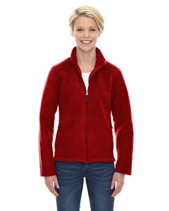
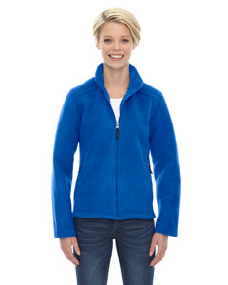
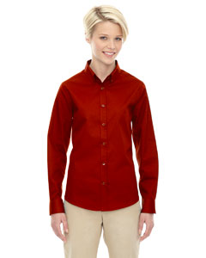
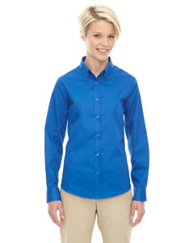
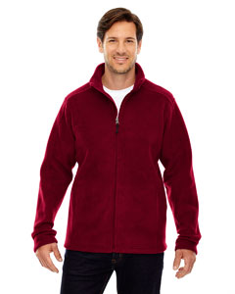
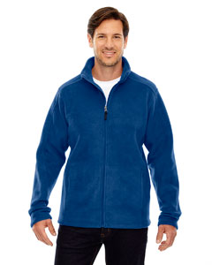
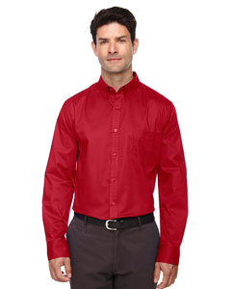
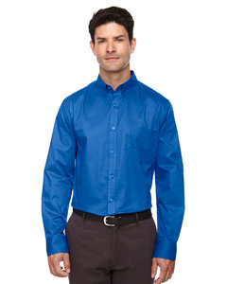
FLEECE
BUTTON-UPS
Pricing
Fleece: $35.00
Button-ups: $35.00
Polos (men only): $35.00
Embroidered Left Side
[Add $5 for 2X or 3X]

Slide 3
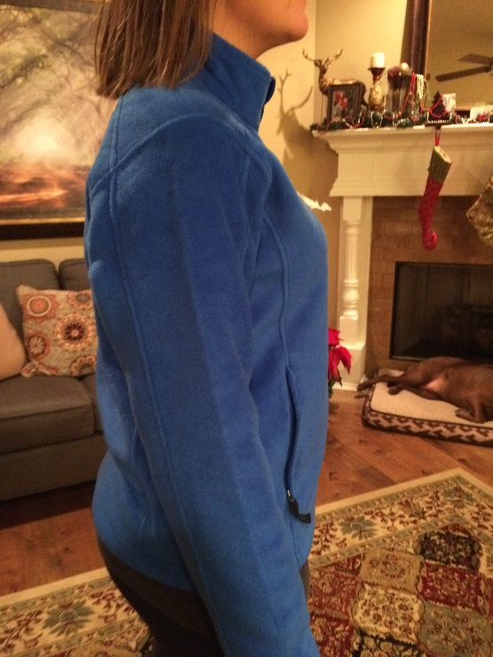
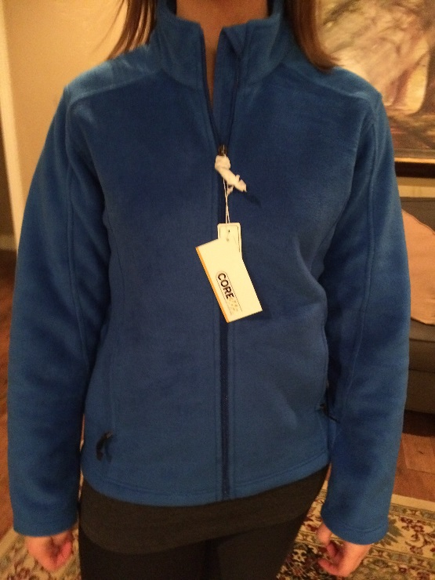
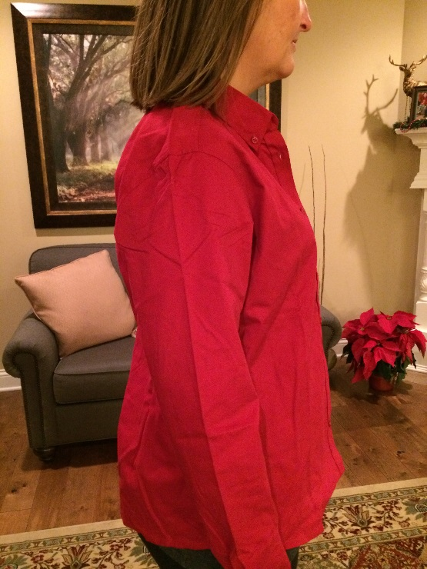
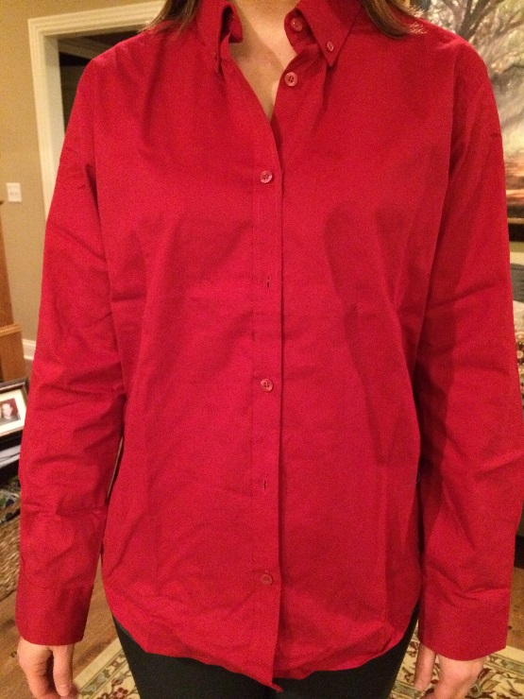
This is the fleece in large. I normally order a medium in shirts or jackets, but this fit perfectly in a large.
This is the button-up in large. I normally order a medium in shirts and will order a medium.

Slide 4
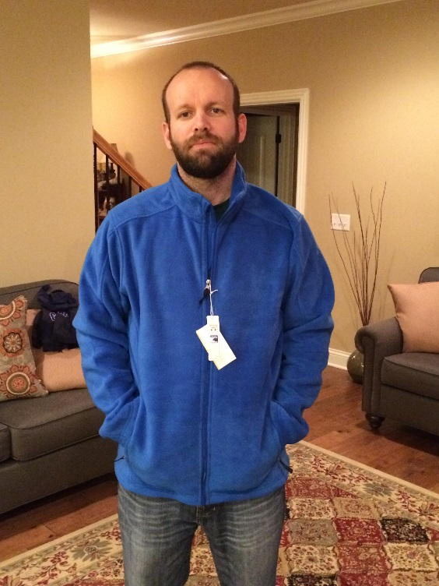
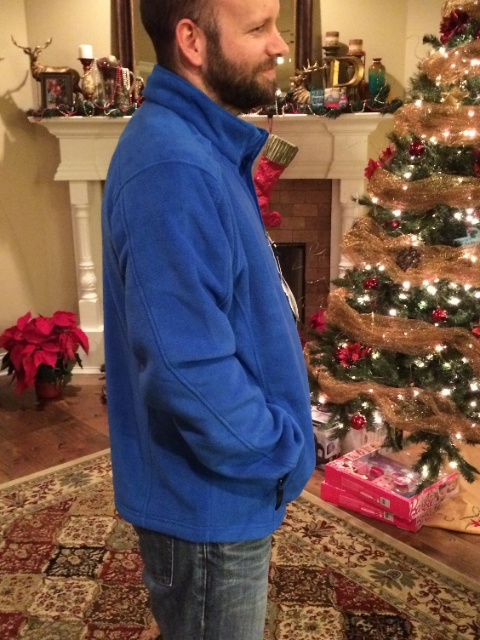
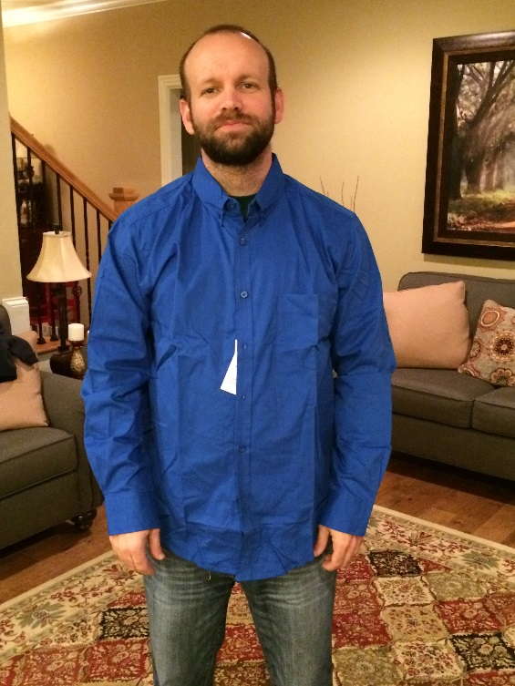
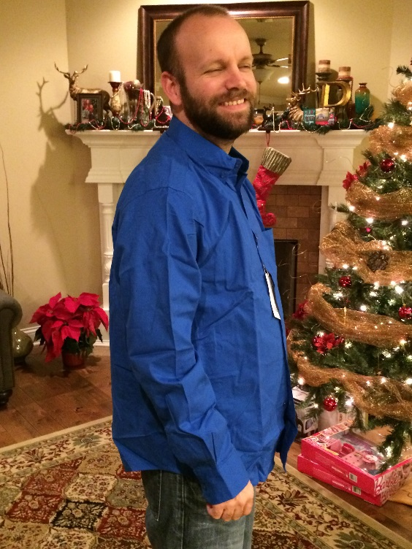
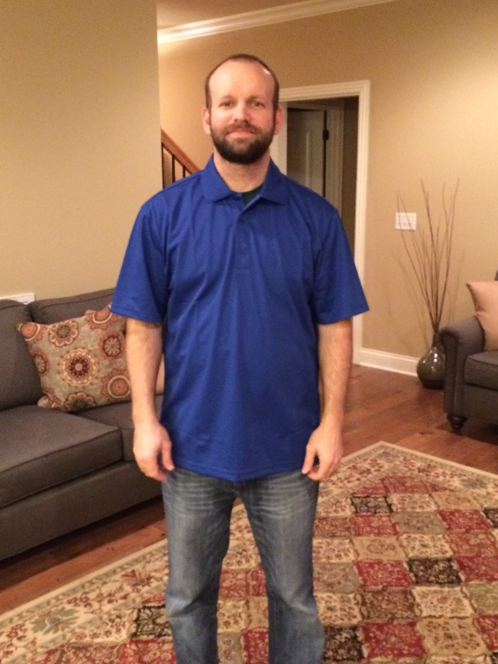
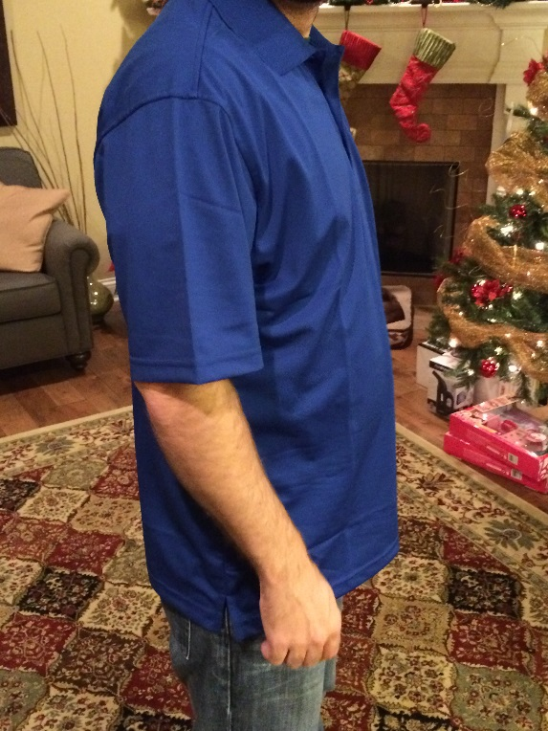
Fleece in large – normally what Jeff would order and fits perfectly.
Button-up shirt in large – Jeff said he likes it. I usually buy him mediums and probably would in this as well. Jeff would buy the large.
Polo in large – This fit Jeff pretty spot-on in length and through the shoulders.

